Slide 1

Short-Term Forecast of Solar Power Generation
Team 35 – Hawraa Salami, Aishwarya Bhangale, Arusha Kelkar, Fairy Gandhi

Slide 2
Agenda
Problem Introduction
Exploratory Data Analysis (EDA)
Data Modeling / Model Evaluation
Results / Conclusion

Slide 3
Problem Introduction

Slide 4
Importance of Forecasting Solar Power Generation
Solar Power is an uncertain renewable energy source.
Solar Power forecasts are important for:
- Grid operators
- Electric Utilities
- Energy traders
- Facility managers

Slide 5
Project Goal
We focus on short- term forecasting: 1 hour and 24 hours ahead.
We consider various machine learning approaches.
Which features can help with the short-term forecast of solar power production?

Slide 6
Data Background
Solar Power Time Series: Total solar power produced by Germany from January 1, 2012 to April 4, 2019 (with hourly resolution)
Weather Time Series: Geographically aggregated weather data
- temperature
- direct radiation
- diffuse radiation
- precipitation
- cloud cover

Slide 7
Exploratory Data Analysis (EDA)

Slide 8
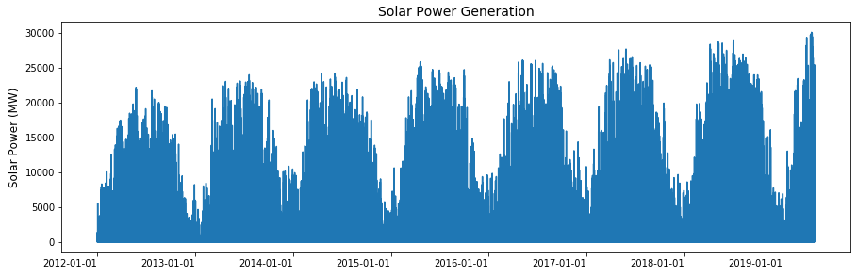
Yearly pattern in solar power production
Notes:
Thank you Hawraa, now lets talk about the exploratory data analysis around the solar and .

Slide 9
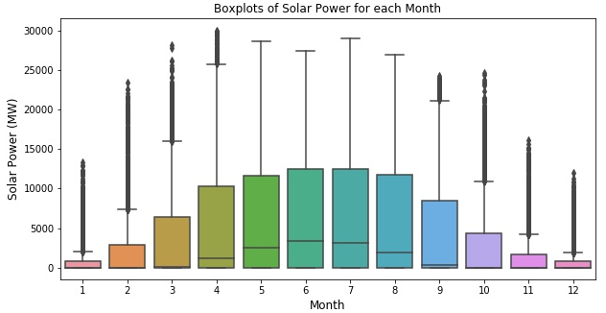
Monthly Variation in Solar Production

Slide 10
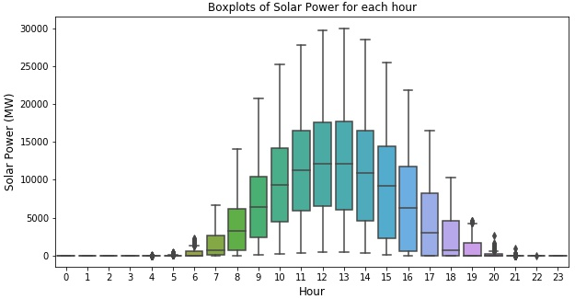
Hourly Variation in Solar Production

Slide 11
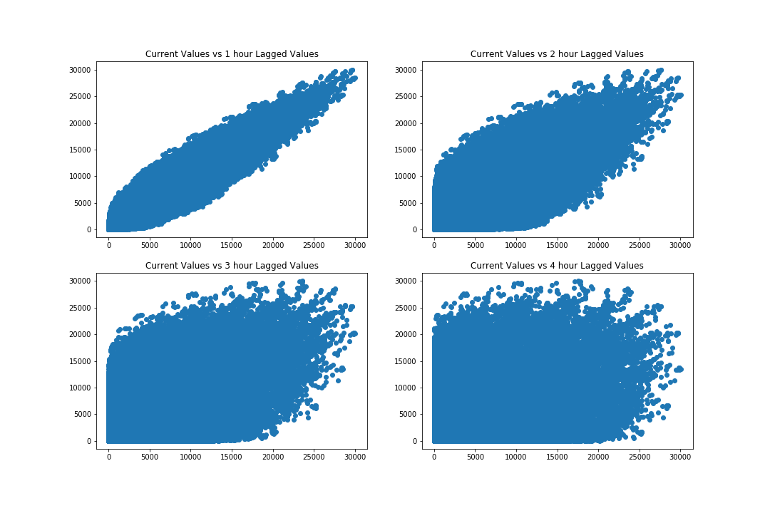
Correlation between Current and Lagged Values

Slide 12
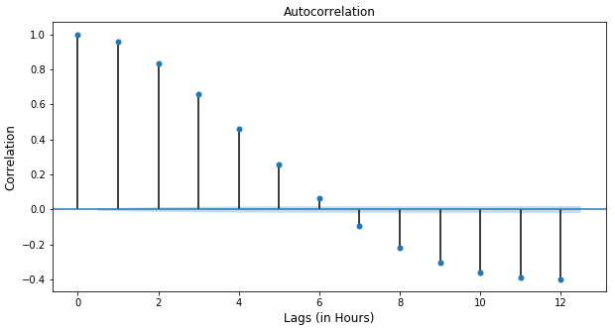
Autocorrelation Function of the Time Series

Slide 13
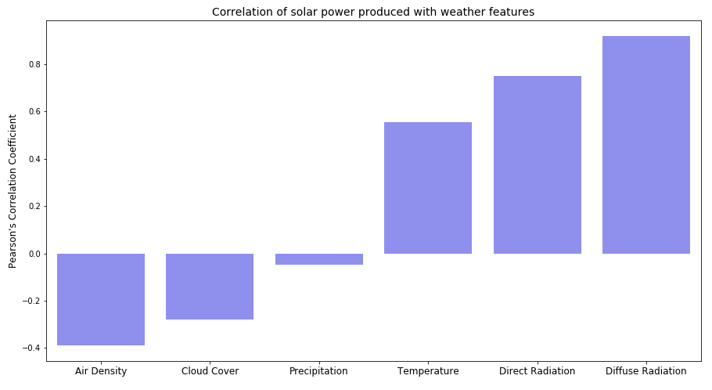
Correlation of Generated Solar Power with Weather Features
Air Density
Cloud Cover
Precipitation
Temperature
Direct Radiation
Diffuse Radiation

Slide 14
Data Modeling / Model Evaluation

Slide 15
Modelling Question (One Hour-Ahead Forecast of Solar Power)
Given the historical solar power production up to hour t-1, and weather data, how can we estimate the solar power that will be produced at hour t ? In other words, can we predict the solar power generated in the consequent hour?

Slide 16
Our Approach
Approach 1:
Weather data at hour t
Time Features (day, hour,
month, year)
Approach 2:
Weather data at hour t
Time Features (day, hour,
month, year)
Solar Power Produced at
the previous 2 hours (t-1, t-2)
Approach 3:
Time Features (day, hour,
month, year)
Solar Power Produced at
the previous 2 hours (t-1, t-2)
?
?
?
Machine Learning Model?
Predict Solar Power at hour t

Slide 17
Model Training
For each approach, we trained different machine learning models
We used nested-cross validation to compare between the performances of each model
Metric used: Root Mean-Squared Error (RMSE)

Slide 18
Results – One Hour-Ahead Forecast
Approach | Model | RMSE - Avg | R-squared - Avg
1. Weather + Time Features | XGBoost | 1079 | 0.94
2. Weather + Time Features + Two Lagged Values | Random Forest | 299 | 0.996
3. Two Lagged Values + Time Features | XGBoost | 271 | 0.996
4. Baseline Model | Persistence Algorithm | 1797 | 0.879

Slide 19
24-Hour (Multi-Step) Forecast of Solar Power
Given the historical solar power production up to hour t-1, and weather data, how can we estimate the solar power that will be produced at hour t, t+1, t+2,.. , t+23 ?
Notes:
Immediate past values of solar power are not now available:
use the predicted values.

Slide 20
Results – 24 Hour Ahead Forecast
Approach | Model | RMSE - Avg | R-squared - Avg
1. Previous two hour values (predicted) + Time Features | Random Forest | 2765 | 0.526
2. Weather + Time Features | XGBoost | 1079 | 0.940
3. Weather + Time Features + two past values (23 hr and 24 hr before) | XGBoost | 1046 | 0.945
4. Baseline Model | Persistence Algorithm | 2042 | 0.827

Slide 21
Conclusion
One-hour ahead forecast: lagged values have important predictive abilities.
24-hour ahead forecast: weather features are important to consider.

Slide 22
Future Work
Enhance the multi-step forecasting model by examining what additional features could be added
Try LSTM (a recursive neural network model) or a hybrid modelling approach
Explore how the predicted values can help with price or load forecast
Compare our results to the current techniques used in forecasting solar power.

Slide 23
Thank You

